Slide 1

LOWES
PRO SERVICES

Slide 2
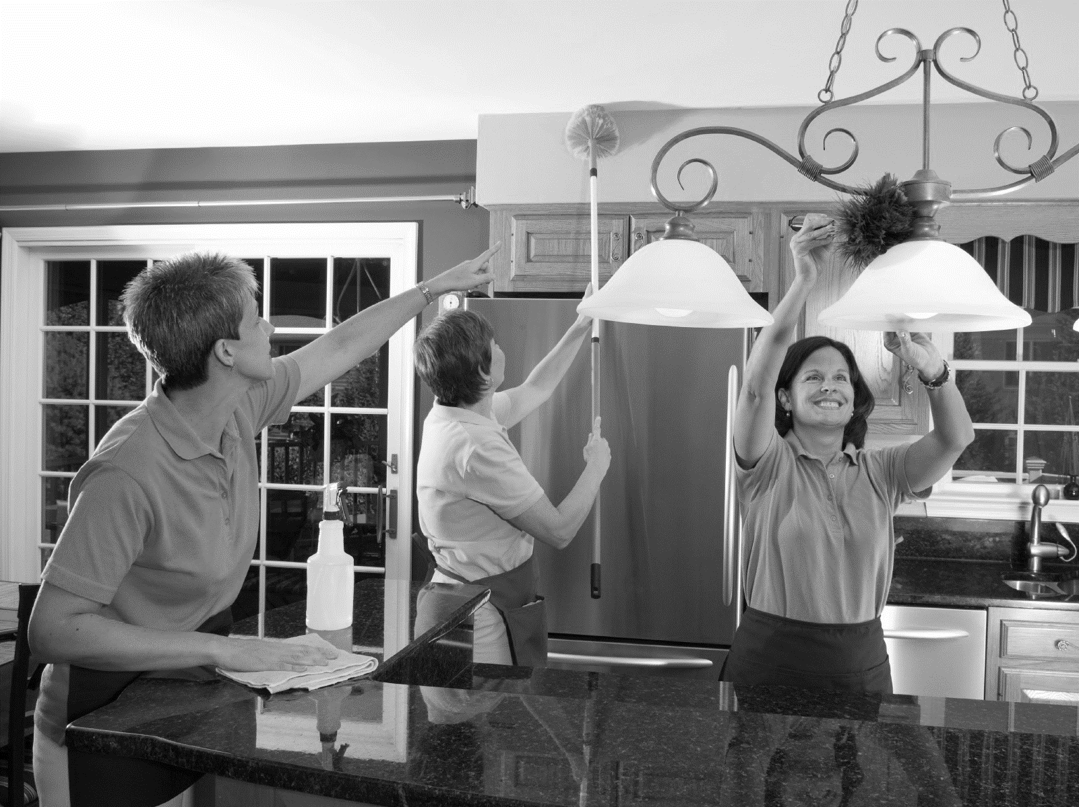



Major Purchasing decisions are influenced by the quality of the After Sales Services
Ease of installation, and procurement of reliable installation services top the list
CUSTOMER INFLUENCES
Installers can not only cross-sell and Upsell but also increase customer retention

Slide 3
INSTALLATION SERVICES AT A GLANCE

Slide 4
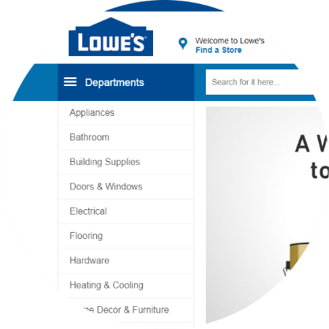



ON THE WEB
ON THE FLOOR
CUSTOMER REQUESTS THE SERVICE VIA THE WEBSITE
LOWES RECEIVES CUSTOMER INFORMATION AND CONTACTS THEM Offline
CUSTOMER REQUESTS RECCOMENDATION FOR INSTALLATION SERVICES
LOWES MAY NOT HAVE AN ACCREDITED LIST OF PROFESSIONALs for the job

Slide 5




Customer leaves the Lowes portal, looks for similar services in competitors websites (eg. home depot, Angies list, Amazon)
Competition offers services that are on demand and satisfies the customers immediate need
BUSINESS IMPACT
Lowes incurs loss from missed commissions, upselling and cross selling opportunities
Disconnected customers, Lost customer Loyalty, Missed Opportunities

Slide 6

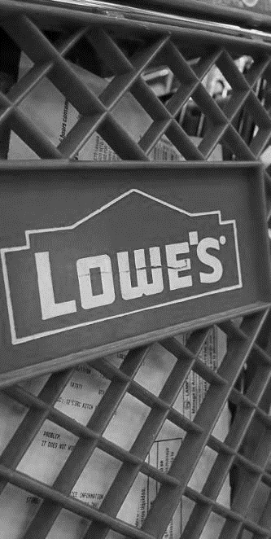



Build rock solid base of prosumers
Attract customers in the first instance
DESIRED OUTCOME
Increase prospects
How do we get there???

Slide 7
OUR SOLUTION
SCENARIO ONE: IN STORE

Slide 8
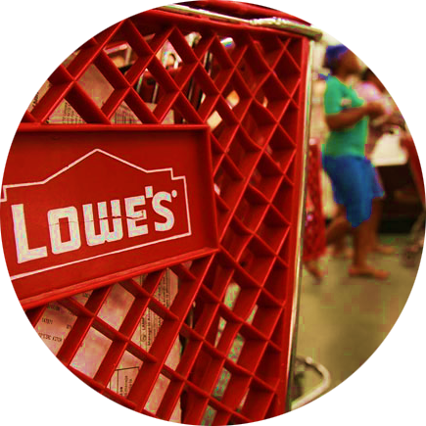

1
CUSTOMER BUYS A BIG TICKET ITEM FROM STORE
2
CSR IDENTIFIES THE CUSTOMER AS A CONSUMER OR SERVICE PROVIDER (Prosumer)

Slide 9




SERVICE PROVIDER
CUSTOMER
3
RECOMMEND THAT THEY JOIN THE LOWES PROSERVICES TEAM
3
RECOMMEND INSTALLATION SERVICES USING A LOWE'S PRO

Slide 10



4
CUSTOMER CONNECTS WITH LOWESPRO AND GET HIS JOB DONE
4
PROSUMER LOGINS TO LOWESPRO PORTAL FOR SIGNUP AND FURTHER PROCESS
CUSTOMER
5
CUSTOMER’S JOB GETS DONE

Slide 11
OUR SOLUTION
SCENARIO TWO: WEBSITE

Slide 12
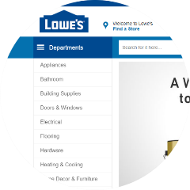

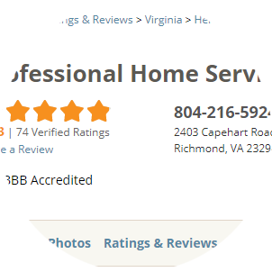
1
IF PROSUMER, THEN RECOMMEND THAT HE JOIN THE LOWES PROSERVICES TEAM
1
CONSUMER BUYS ITEM FROM WEB SITE
2
DEPENDING ON CONTEXT, A PROFESSIONAL SERVICE IS RECOMMENDED BY THE APPLICATION
2
PROSUMER LOGINS TO LOWESPRO PORTAL FOR SIGNUP AND FURTHER PROCESS

Slide 13
ONE STOP SOLUTION
TO BRIDGE THE GAPS

Slide 14




Our Solution
Store and Ecommerce portal
LOWESPro Connect
Intelligent
e-Verification
Background check (API Based)
Face to face training on acceptable service standards

Slide 15
THANK YOU

